Slide 1


IoT Security Preparing for the worst
Cyber Sec
Satria Ady Pradana
From attackers perspective

Slide 2
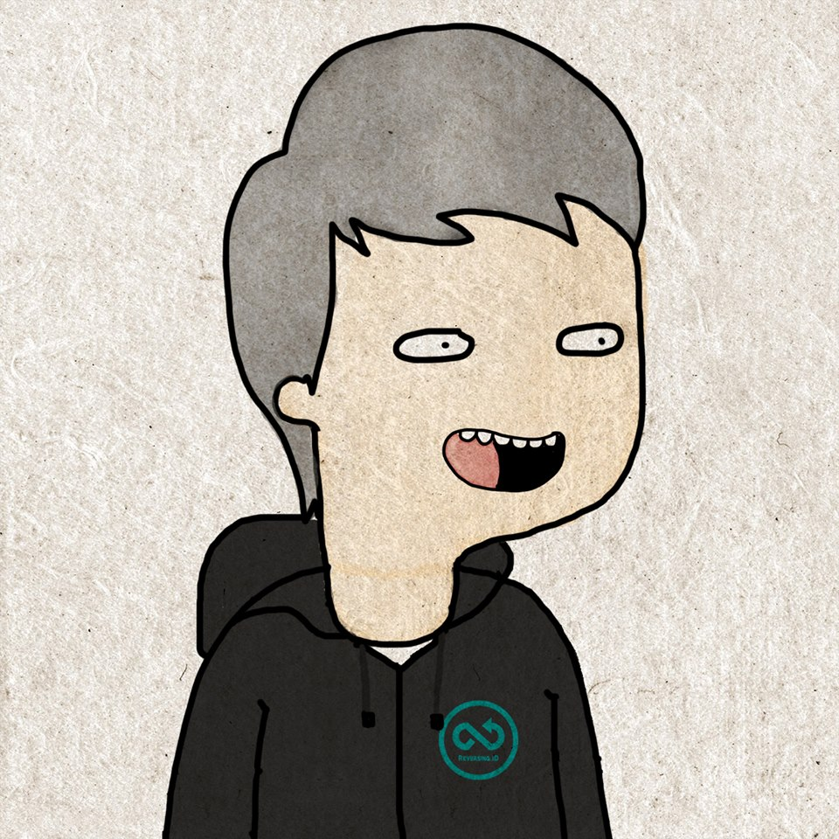



About Me
Hi!
Satria Ady Pradana
Cyber Security Consultant of Mitra Integrasi Informatika
Penetration Tester, Red Team
IoT / OT Cyber Security Special Interest Group
Community Leader of Reversing.ID
Love Low-Level Stuffs
xathrya
xathrya
@xathrya

Slide 3
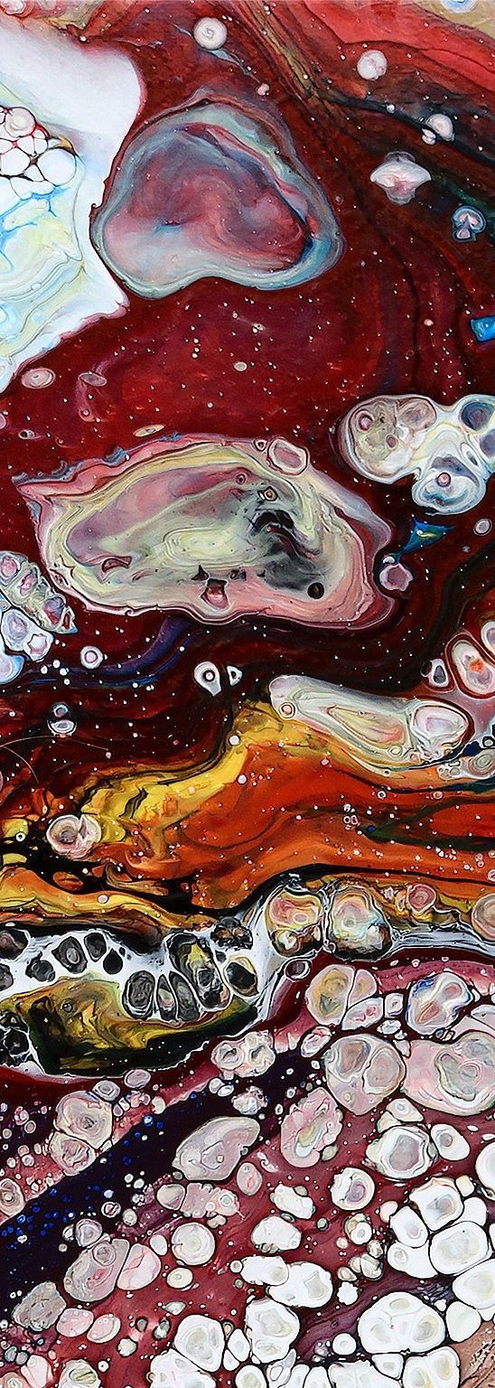
Agenda
IoT Security : Preparing for the Worst
Introduction to IoT
Trends and Forecasting
Threats against IoT
Prepare for Defense

Slide 4
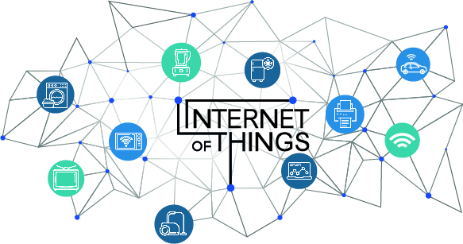
Small; Connected; Continuous

Slide 5






































Exponential IoT Growth
IoT Devices
PC’s & Mobile Devices
Took 25 years to get to 10 Billion devices*
Will take only 5 years to get to 30 Billion devices*
Source: Gartner IoT, PC and Mobile device forecast 2015
Reference acronym glossary at the end of presentation

Slide 6
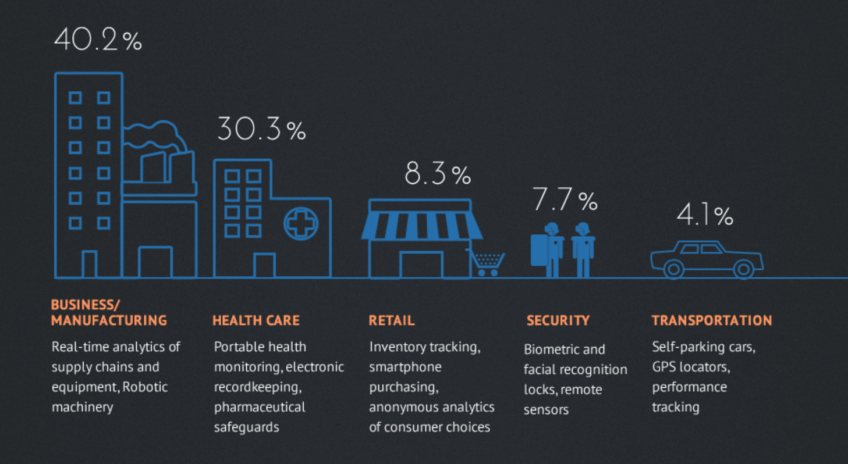
IoT – Where Are They?
Source: Intel

Slide 7

IoT + Industry 4.0
… and security as integral part of system

Slide 8
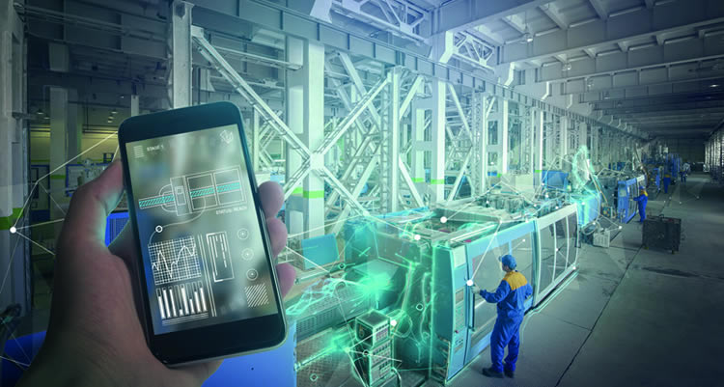
Smart Factory
Notes:
Features:
Get the current condition of machine
Detect anomaly of production machine
Coordinated goods transporting between warehouse and machine.
Results:
Predict machine wear off

Slide 9
Unification of Technology
Digitalization and connection of all actors in the value process.
Cyber-physical systems monitor the physical process of the factory and make decentralized decisions.
Cyber-physical systems are intelligent
Logistics units are communicating with each other.
Use data to make predictive, corrective, adaptive decision to improve efficiency.
CONNECTIVITY
ANALYTICS
SECURITY

Slide 10
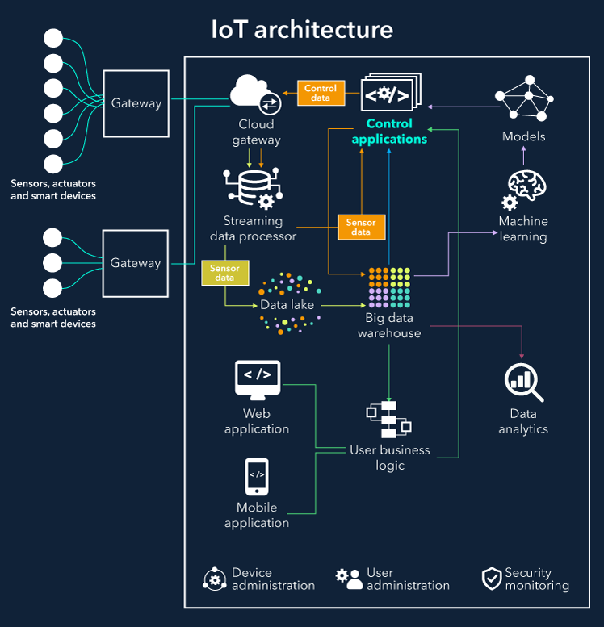
Nodes
Edge Gateway
Cloud Gateway
Data storage
Analytics
User business

Slide 11
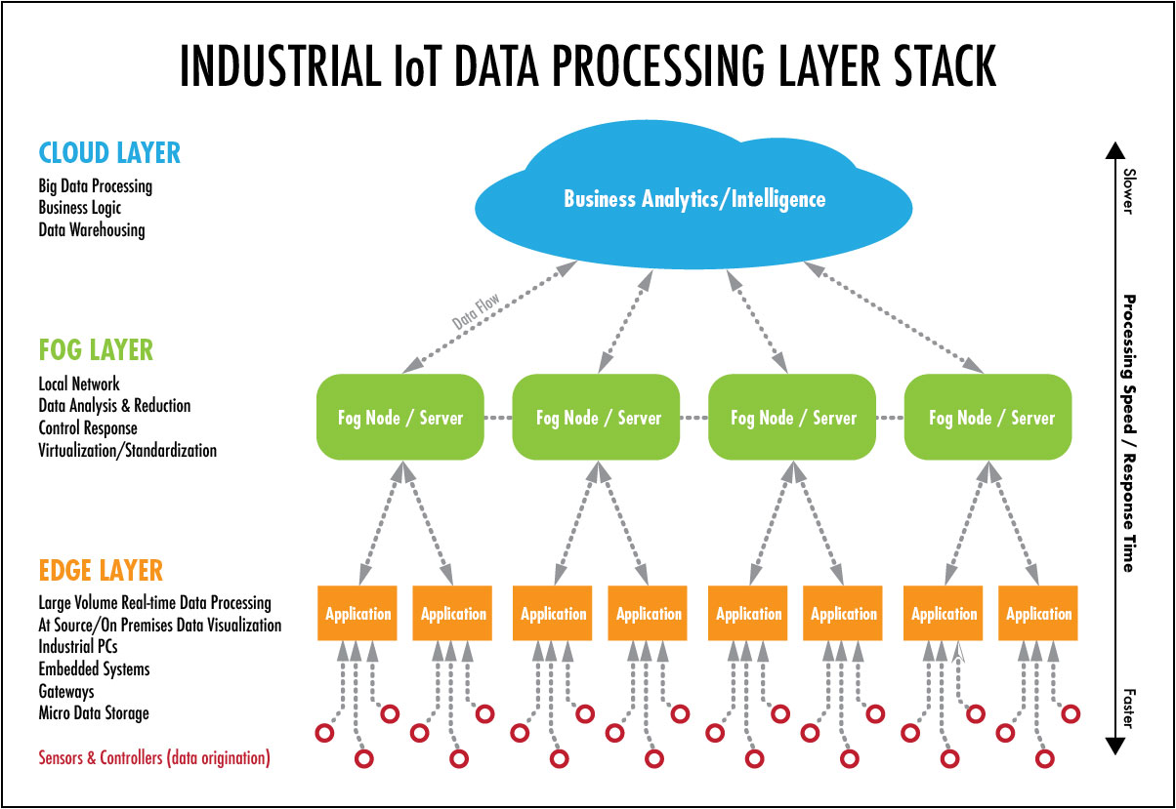

Slide 12

Attacking the “Invisible”
How devices are targeted to gain desired access to organization.

Slide 13
Danger Classification
DISASTROUS
Cause irreversible damage
DISRUPTIVE
Disrupt operational processes.
What if,
it can be intentionally triggered?
DAMAGING
Enable information stealing
Notes:
Function failure -> can happen to any system.
Failure can lead to danger.
What if the failure can be intentionally triggered?

Slide 14
Security Issues
Authentication: how to prove identities claimed by devices or users?
Authorization: what set of actions a user can do?
Update: how do we upgrade the system or part of it?
communication:
how do we ensure no one can read or modify the messages?
how do we detect and response to disruption the communication channel?
Data: how do we ensure the generated data are valid?

Slide 15

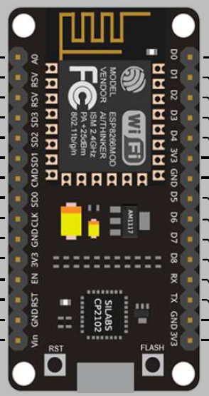
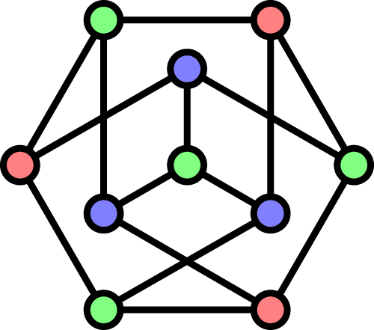
Attack on IOT
Things
Network
Compute

Slide 16
Attack: the things
Get the Machine
Change behavior
Take over
Disable
GOAL

Slide 17
Attack: the things
Get the Machine
Exploitation (memory corruption, race condition, etc.)
Injection (command or telemetry)
Code Rewrite (firmware replace or downgrade)
Side-Channel (timing, hardware glitching, power analysis)
Hardcoded secret
TECHNIQUE

Slide 18
Attack: the NETWORK
GOAL
Disrupt communication
Analysis
TECHNIQUE
Replay attack
Spoofing
Packet Tampering
Jamming or Flooding
Protocol Specific exploitation

Slide 19
ATTACK: THE COMPUTE
GOAL
Take over
Data Exfiltration
Data Modification
TECHNIQUE
Injection (command, query, telemetry)
Broken Session
Data poisoning

Slide 20
SECURITY IS SERIOUS CONCERN

Slide 21

Slide Title
STUDY CASES
If you know the enemy and know yourself, you need not fear the result of a hundred battles…
-- Sun Tzu, The Art of War

Slide 22
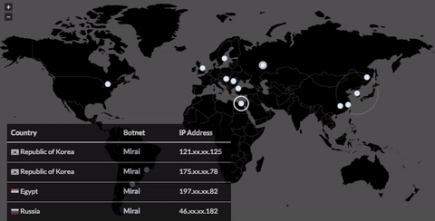
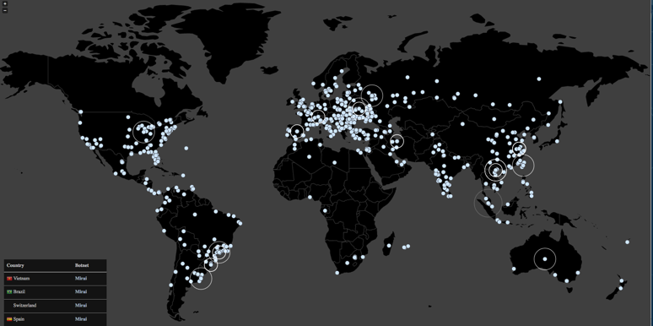
2016
Mirai used in DynDNS attack on ~450K devices involved.
Targeting connected devices to launch largest DDoS attack, disrupting internet.
Mirai Botnet
11/1/2016
22

Slide 23

2015
Employing sophisticated malware – BlackEnergy3
Attack on power grid regions:
Intruded and damaged SCADA system hosts and workstations
Seized control at HM level, blindsided system dispatchers
Opened substation breakers cutting power to 225,000 customers
Initiated DDoS attack on call centers to prevent users reporting outages.
Cyber Attack on Ukrainian Power Grid

Slide 24
Attacks launched within 30 minutes of each other
More than 50 substations had breakers remotely opened
Step 1 of the 2 steps of Aurora (Step 2 is remotely reclosing the breakers out-of-phase with the grid)
Local operators were locked out of their own workstations
Attackers changed passwords for key systems
Attackers corrupted firmware of serial-to-Ethernet converters requiring replacement
RTU with Windows HMI card overwritten by Killdisk
UPS devices used to impact restoration
Cyber Attack on Ukrainian Power Grid

Slide 25
PREPARING THE WORST

Slide 26
Checklist
Understand what you have deployed, what is interconnected, and what is connected to the internet
Discover, Classify, and Assess devices on the network
Scan the network periodically and monitor to identify anomalous network behavior.
Review the design, implementation, and maintenance of overall plant architecture.
Implement policies and act accordingly

Slide 27





Thank You
Cyber Sec
Satria Ady Pradana
+62 89 774 239 35
Satria.Pradana@mii.co.id
@xathrya (telegram)

